Slide 1
Chapter 3
Addressing Modes
Barry B. Brey
bbrey@ee.net

Slide 2
Mapa de memoria física
Inicio Dirección
Dec Hex
960K F0000
768K C0000
640K A0000
0 00000
Uso
------------------
Memoria superior
------------------
Memoria convencional
------------------
64K sistema base de ROM
192K área de expansión de memoria (ROM)
128K área de despliegue de video (RAM)
640K memoria (RAM)

Slide 3
Addressing Modes
In order to write a program addressing modes must be thoroughly understood.
There are many addressing modes, but the most common are easy to master and represent most instructions in most programs.
Register addressing, immediate addressing, direct addressing, and simple forms of indirect addressing are the most common addressing modes.

Slide 4
Stack addressing is also used with the PUSH and POP instructions and as a way to link a program to its procedures or functions.
Program flow instructions are either unconditional or conditional.
Conditional program flow instructions are the “if” statements of assembly language.

Slide 5
Data Addressing Modes: MOV
Data addressing modes are presents with the MOV instruction because it is by far the most common instruction in a program.
MOV really moves nothing. MOV copies the source into the destination. It probably should be named COP for copy, but it is not.

Slide 6
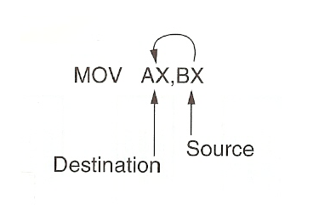

Slide 7
Register
MOV EAX,EBX
MOV CX,DX
MOV AH,AL
MOV AX,DS
MOV ES,CX
ADD AL,CL (most instructions use it)
OR AX,DX

Slide 8
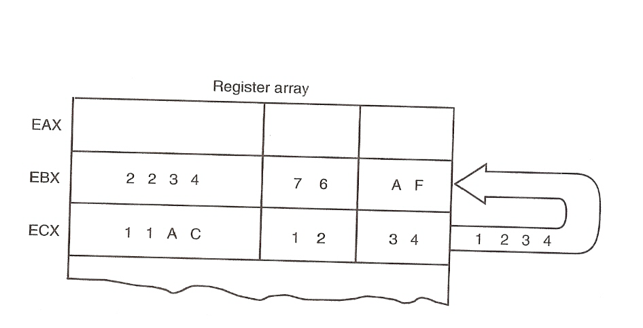

Slide 9
Immediate
MOV EAX,234H
MOV CX,2
MOV AL,34H
ADD AL,3
SUB CL,4
AND EAX,1

Slide 10
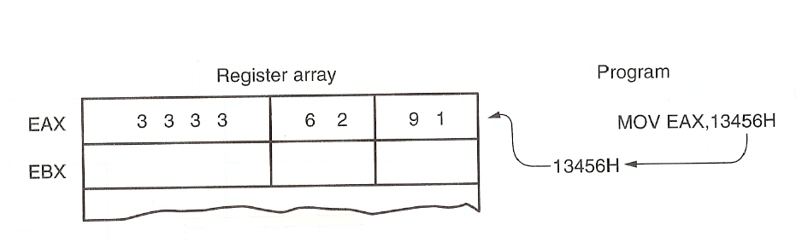

Slide 11
Direct
MOV BOB,EAX
MOV FRED,CX
MOV BILLY,AL
MOV EDI,RALPH
MOV AX,STEVE
MOV DS,BARNEY
MOV AL,DS:[1000H]

Slide 12
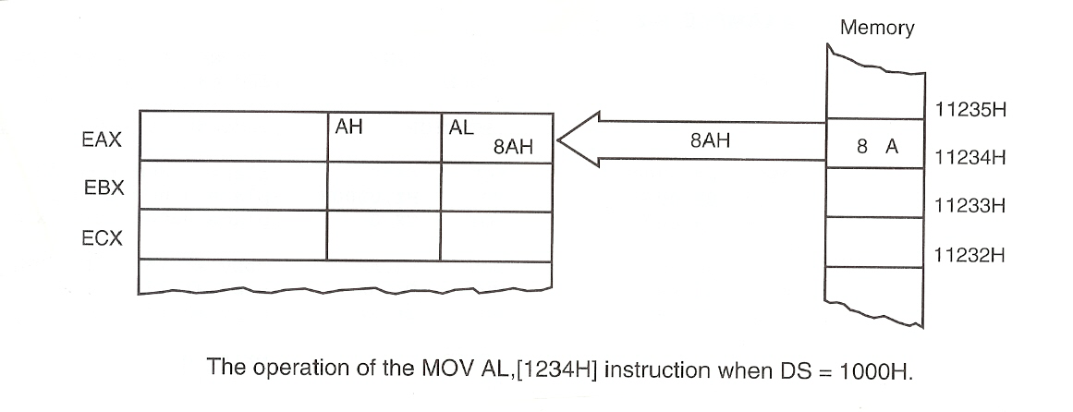

Slide 13
Register Indirect
MOV AL,[BX]
MOV AX[EBX]
MOV [EDI],EAX
MOV [EAX],EDX
MOV BYTE PTR [EAX],6
MOV WORD PTR [ECX],12
MOV DWORD PTR [ESI],2345H

Slide 14
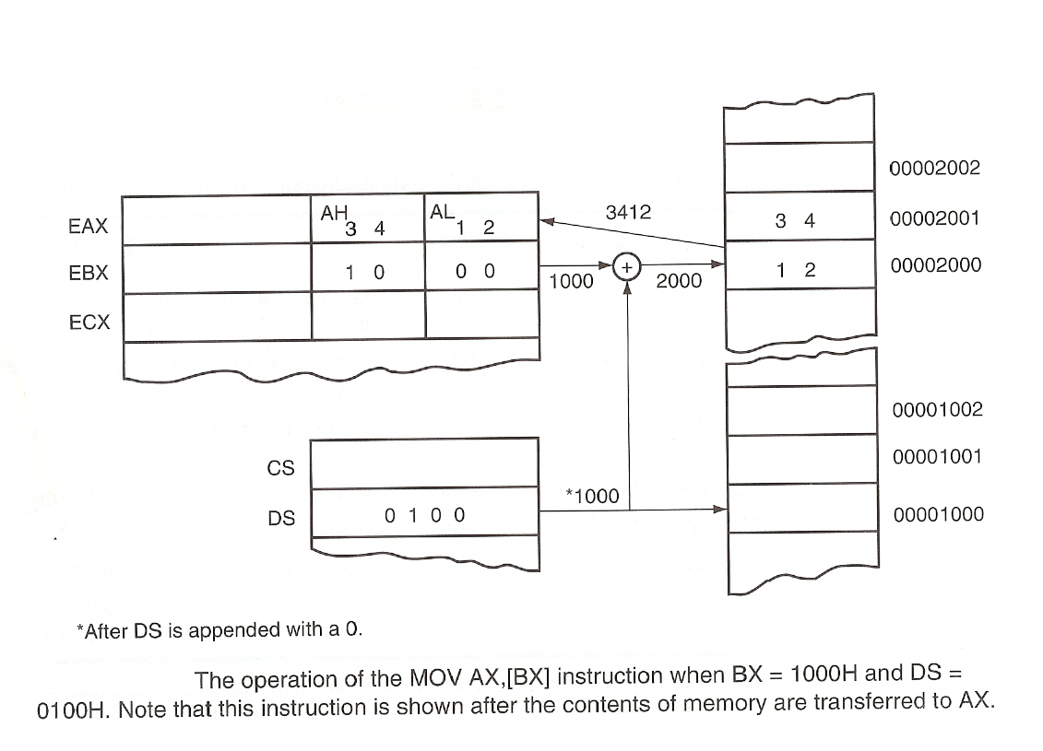

Slide 15
Base Plus Index
MOV AL,[BX+SI]
MOV [BX+DI],AX
MOV [BP+SI],EAX
MOV AL,[BP+DI]
MOV WORD PTR [BX+SI],5
ADD AL,[BX+DI]

Slide 16
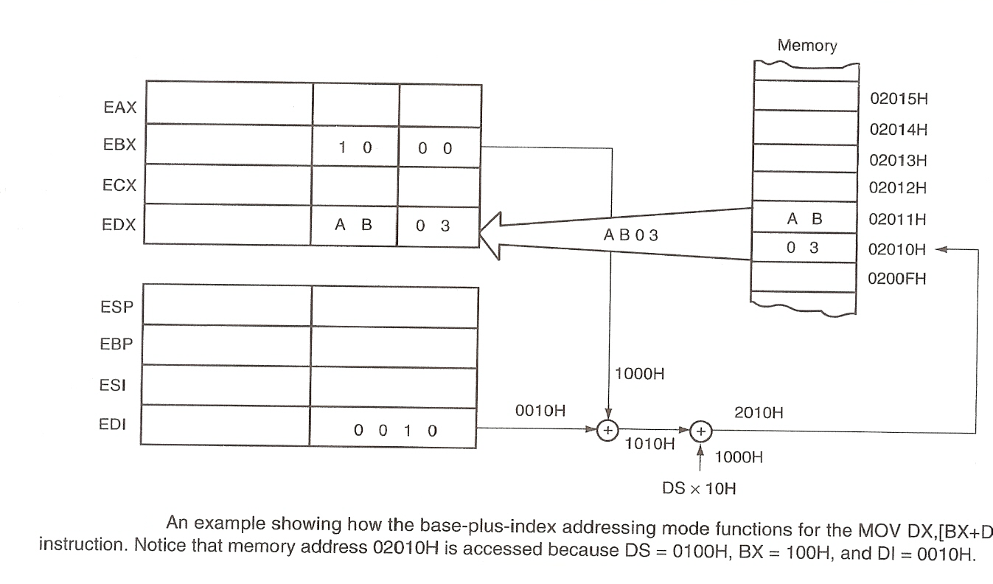

Slide 17
Register Relative
MOV AL,[BX+3]
MOV AX,[DI+20H]
MOV [EDI+200H],EAX
MOV [BX-33],ECX
ADD BYTE PTR [BX+2],5

Slide 18
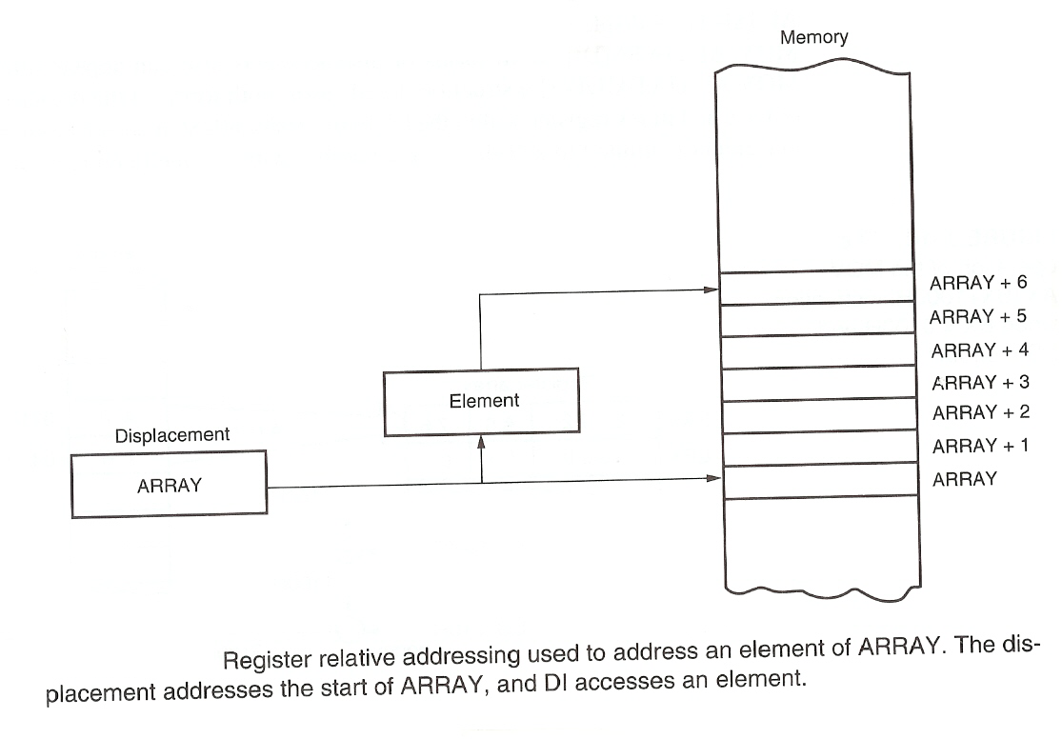

Slide 19
Relative Plus Index
MOV AL,[BX+SI+22]
MOV [BX+DI-22],AX
MOV EAX,[EBX+EDI+100H]

Slide 20
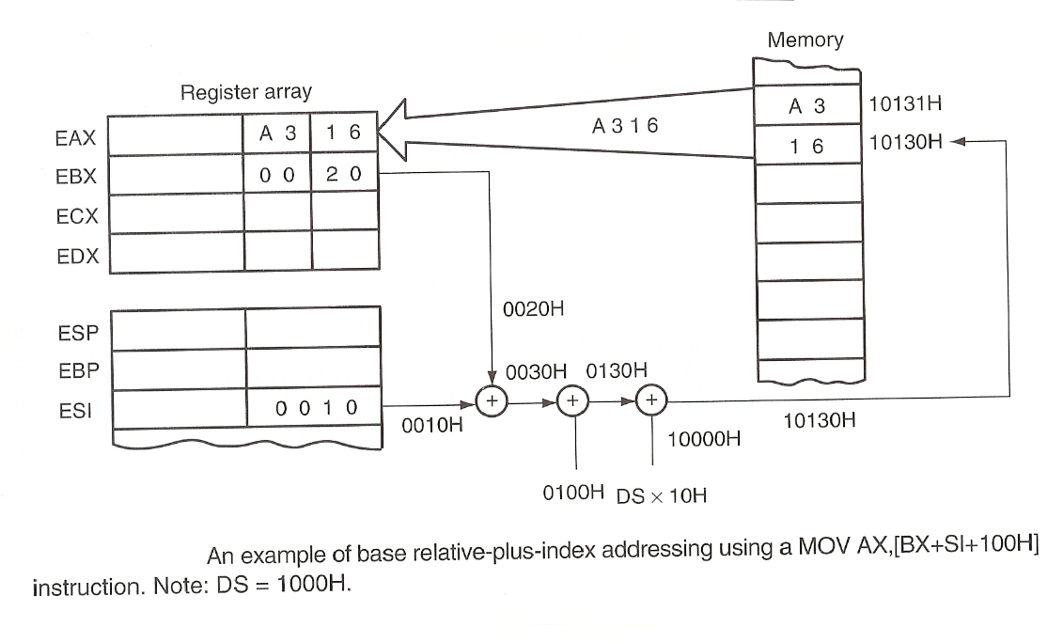

Slide 21
Scaled Index
MOV EAX,[EBX+ 4*ECX]
MOV AX,[EDI+2*EBX]
MOV [EAX+2*EBX],DX
MOV [4*ECX],EBX
ADD AL,[ECX+EBX]

Slide 22
Program Flow
Program flow instruction are unconditional (JMP) or conditional (JNZ).
Flow instructions are short (+127, -128), near (±32K), or far (anywhere in the memory).
Conditionals do not contain the far type.
Labels are followed by a colon if they are jumped to in a program.
Notes:
Colon: dos puntos

Slide 23
Stack Addressing
The SS (stack segment) and the SP/ESP are added to form an address in the stack.
The stack is an area of memory that functions as a last-in, first-out (LIFO) memory. That is if a 1 followed by a 2 are placed on the stack the 2 comes out of the stack first, followed by the 1.
PUSH and POP are used to store data on the stack and to remove data from the stack as words or doubleword,

Slide 24
PUSH AX
PUSH EAX
POP AX
POP EAX
PUSH BOB
POP BOB
PUSHF
POPF

Slide 25
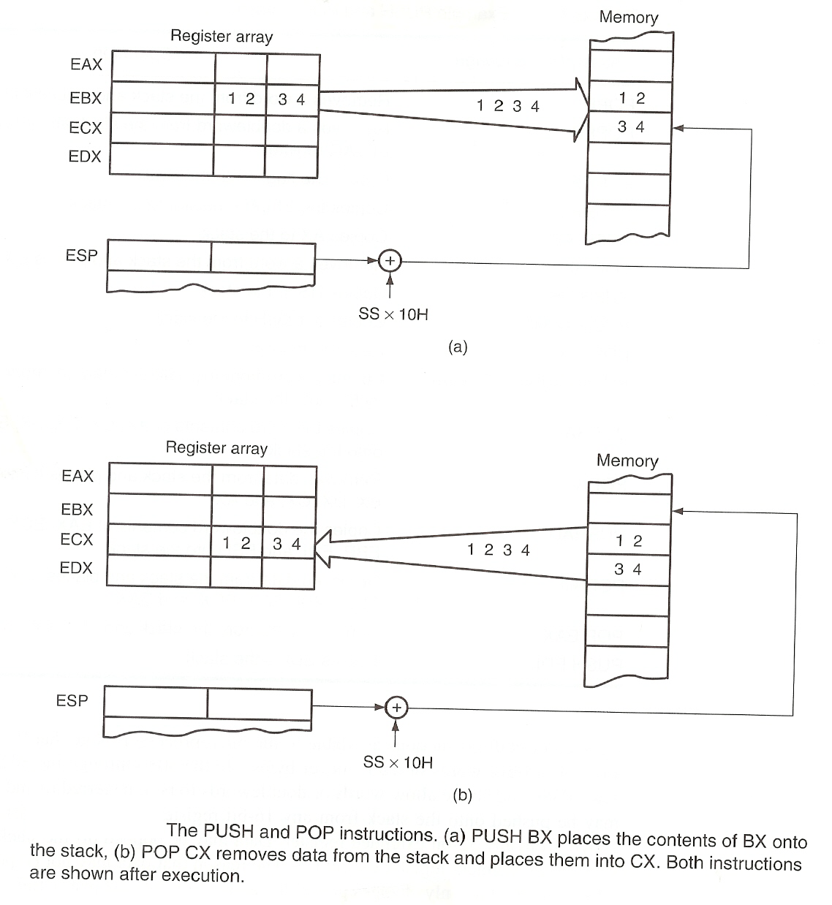

Slide 26
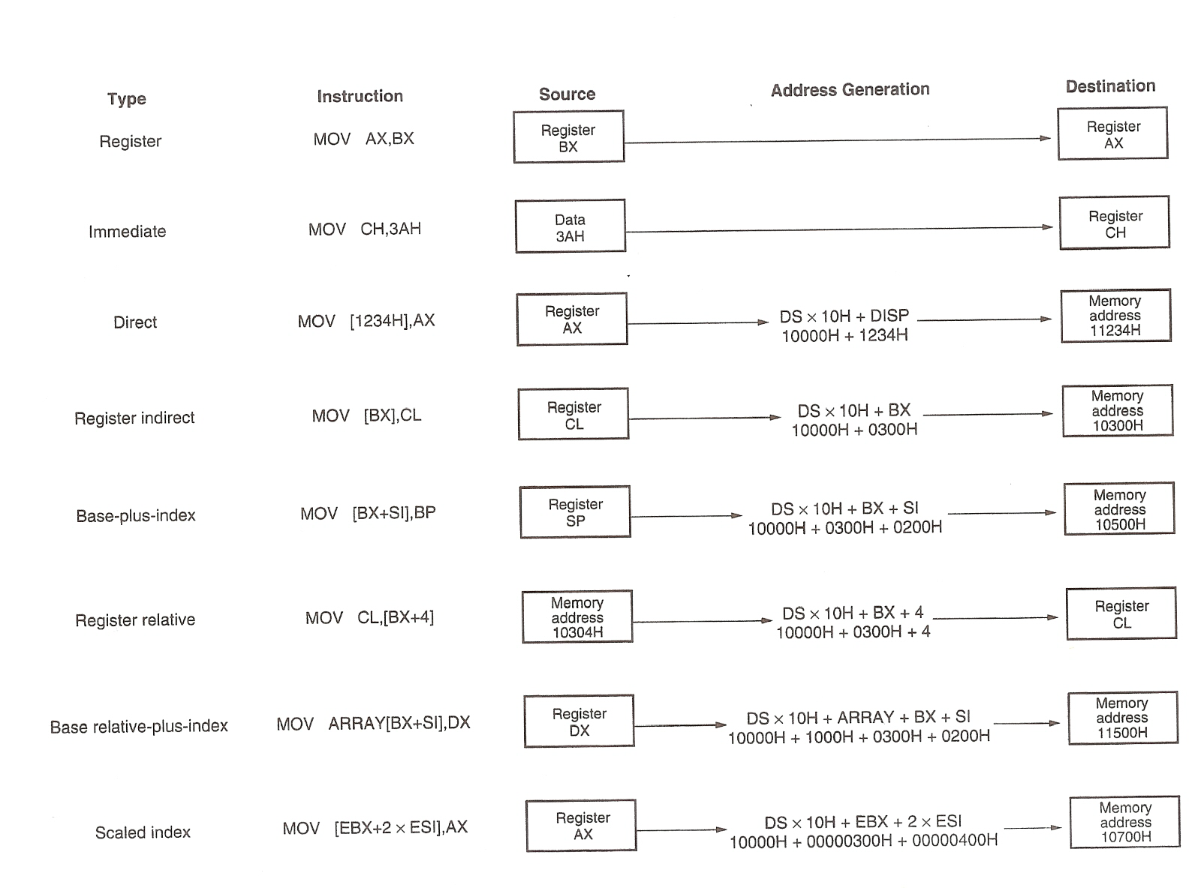

Slide 27
Bibliografía
Brey, The Intel Microprocessors, 7th edition, Pearson Education, 2006.
Abel, P., Lenguaje ensamblador y programación para IBM PC y compatibles, 3ª edición, Prentice Hall.

